Slide 1
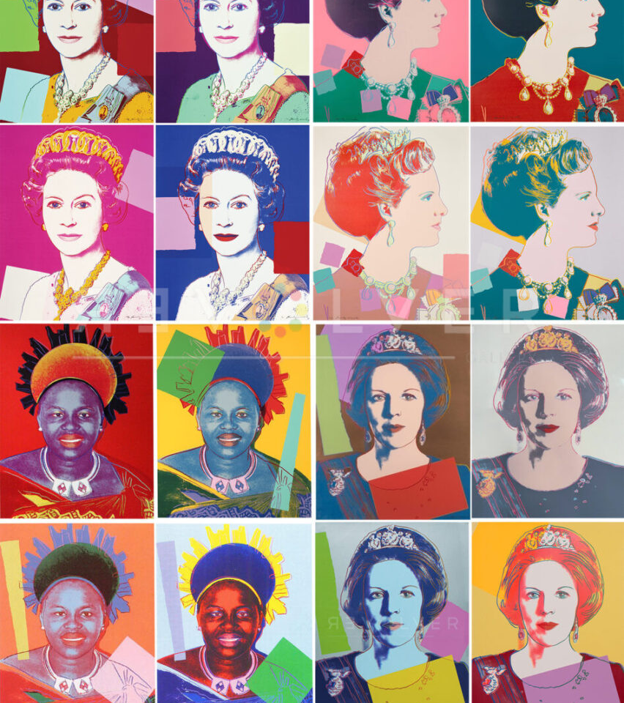
Coloring Queens with Thousands of Encodings
Bernardo Subercaseaux (bersub@cmu.edu)
Joint work with Benjamin Przybocki and Marijn Heule

Slide 2
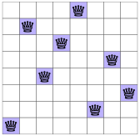
8 queens solution

Slide 3
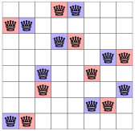
Two disjoint 8 queens solutions

Slide 4
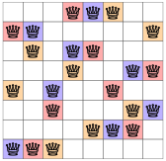
Three disjoint 8 queens solutions

Slide 5
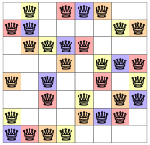
Four disjoint 8 queens solutions

Slide 6
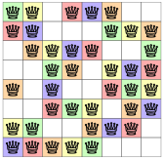
Five disjoint 8 queens solutions

Slide 7
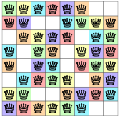
Six disjoint 8 queens solutions

Slide 8
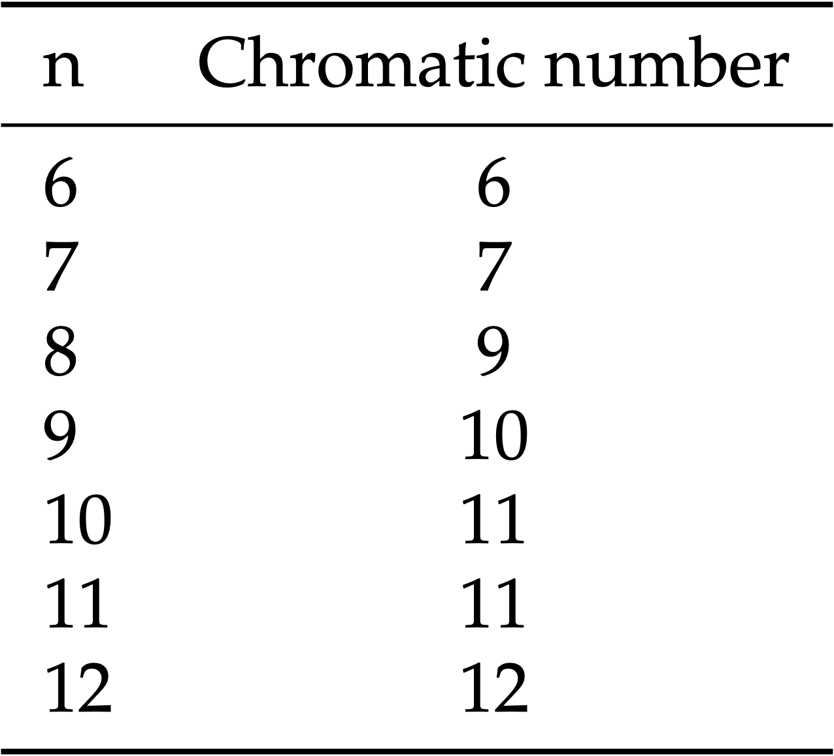
Chromatic Number of the Queen’s Graph

Slide 9

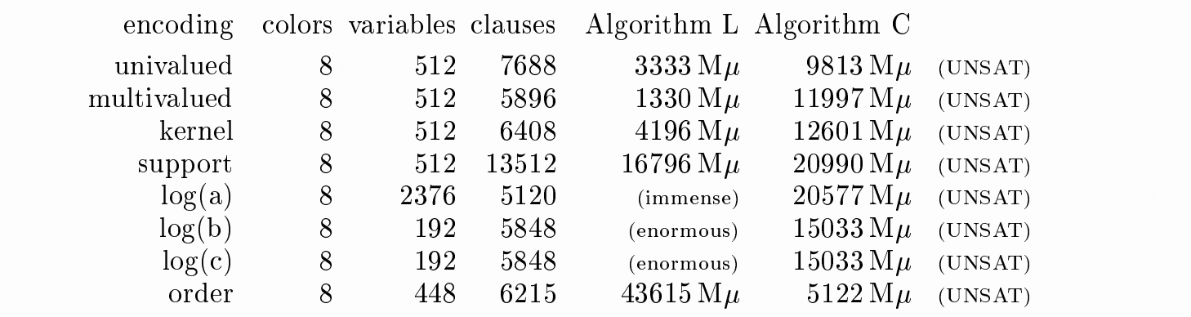
Knuth benchmarked ~10 encodings
(TAOCP 7.2.2.2)

Slide 10
We benchmarked >1000 encodings

Slide 11
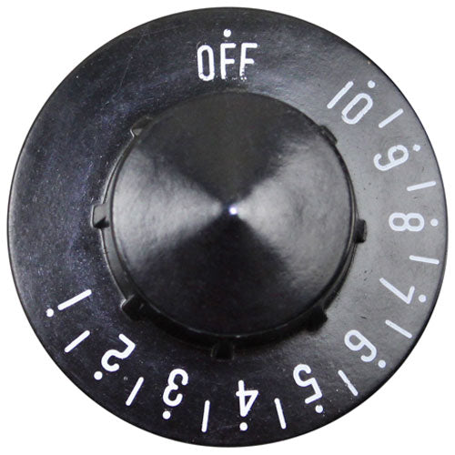
We benchmarked >1000 encodings
Within cells
Between cells
Symmetry
Breaking

Slide 12

Within Cells
Each cel
Cell (i, j) gets color k
Each cell must have At Least One color
Each cell must have Exactly One color

Slide 13
Within Cells
Each cel
Cell (i, j) gets color k
Each cell must have At Least One color
Each cell must have Exactly One color
3-4) Order encodings: cell (i, j) gets color ≤ k

Slide 14
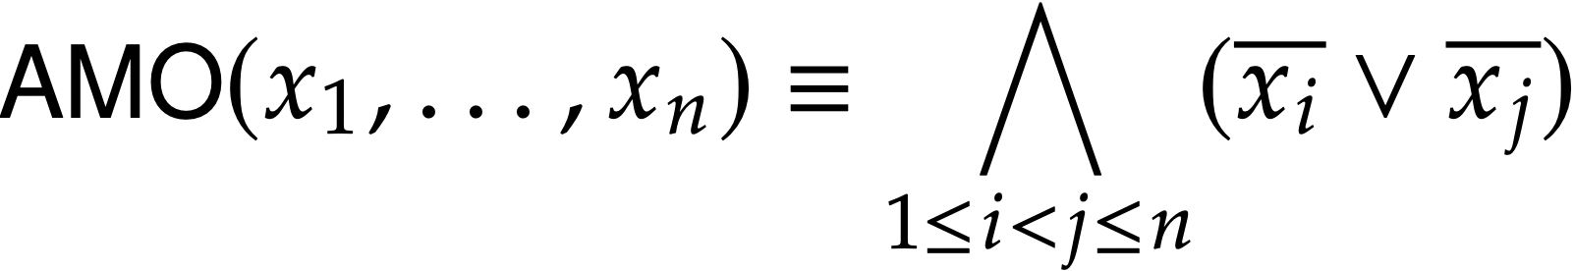
At Most One encodings
Direct

Slide 15
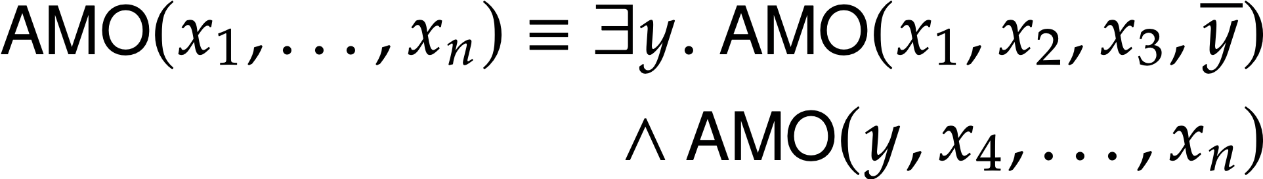
At Most One encodings
Direct
Recursive

Slide 16
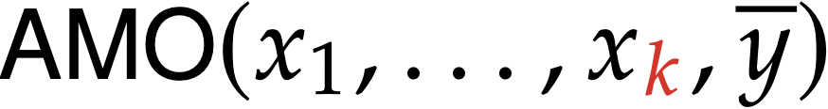
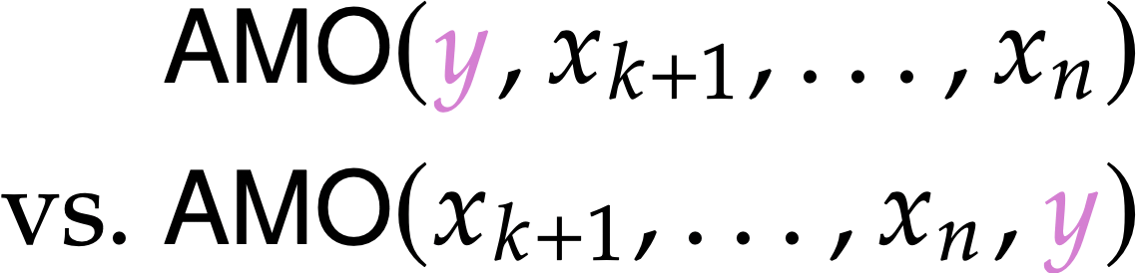
At Most One encodings
Recursive
Cut parameter:
Aux placement:

Slide 17
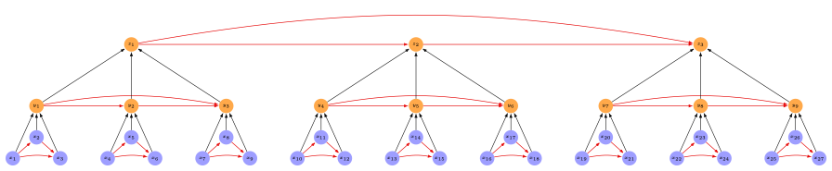


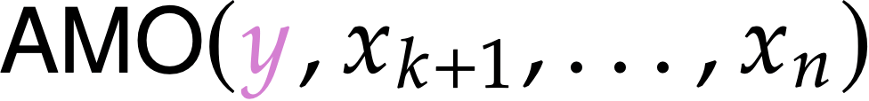
Pooled
Cf. Nawrocki et al. SAT’2021
Linear

Slide 18
Between Cells
Two cells on the same row, column, or diagonal
cannot have the same color

Slide 19
Between Cells
Two cells on the same row, column, or diagonal
cannot have the same color
for each row, column, or diagonal S:
for each color k:
At Most One cell in S gets color k

Slide 20
Between Cells
Two cells on the same row, column, or diagonal
cannot have the same color
for each row, column, or diagonal S:
for each color k:
At Most One cell in S gets color k
Exactly

Slide 21
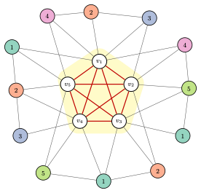
We are trying to find a 5-coloring
and there’s a 5-clique

Slide 22
We are trying to find a 5-coloring
and there’s a 5-clique
Then some vertex in the 5-clique
must get color 3 !

Slide 23
We are trying to find a 5-coloring
and there’s a 5-clique
Then some vertex in the 5-clique
must get color 3 !
Otherwise we would only have 4 colors for 5 vertices!

Slide 24
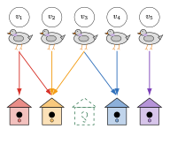
Otherwise we would only have 4 colors for 5 vertices!

Slide 25
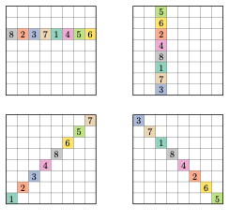
Clique Hints

Slide 26
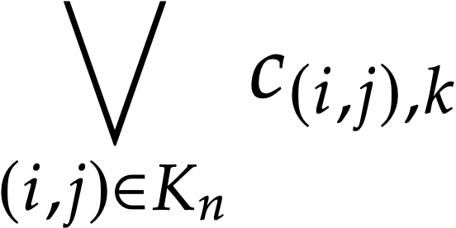
Clique Hints
For each color k in {1, …, n}
B

Slide 27
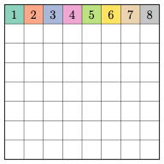
Symmetry Breaking
Row 1, used by Knuth

Slide 28
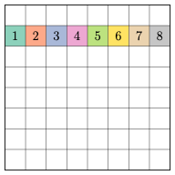
Symmetry Breaking
Row 2

Slide 29
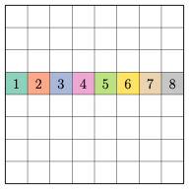
Symmetry Breaking
Row 4

Slide 30
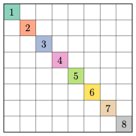
Symmetry Breaking
Main diagonal

Slide 31
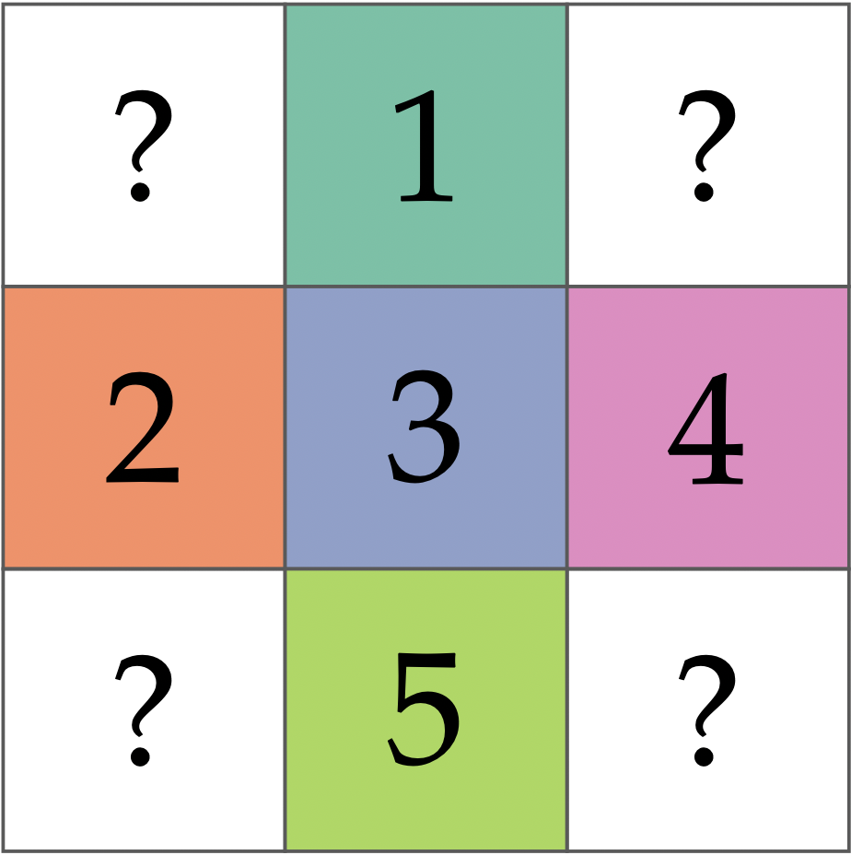
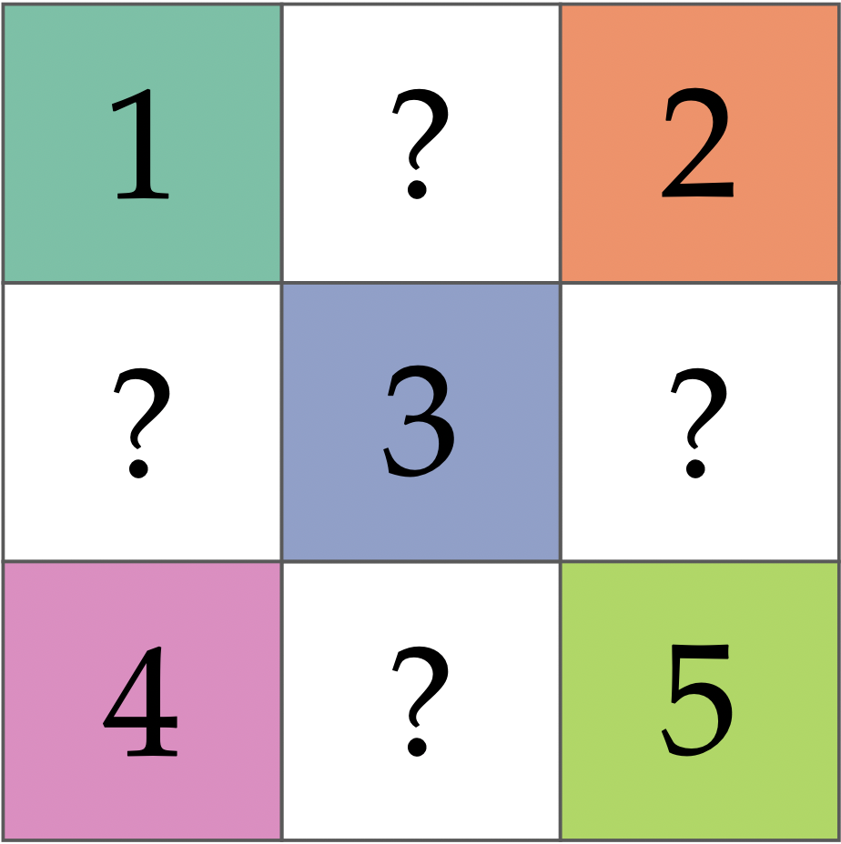
Symmetry Breaking
Plus
Cross

Slide 32
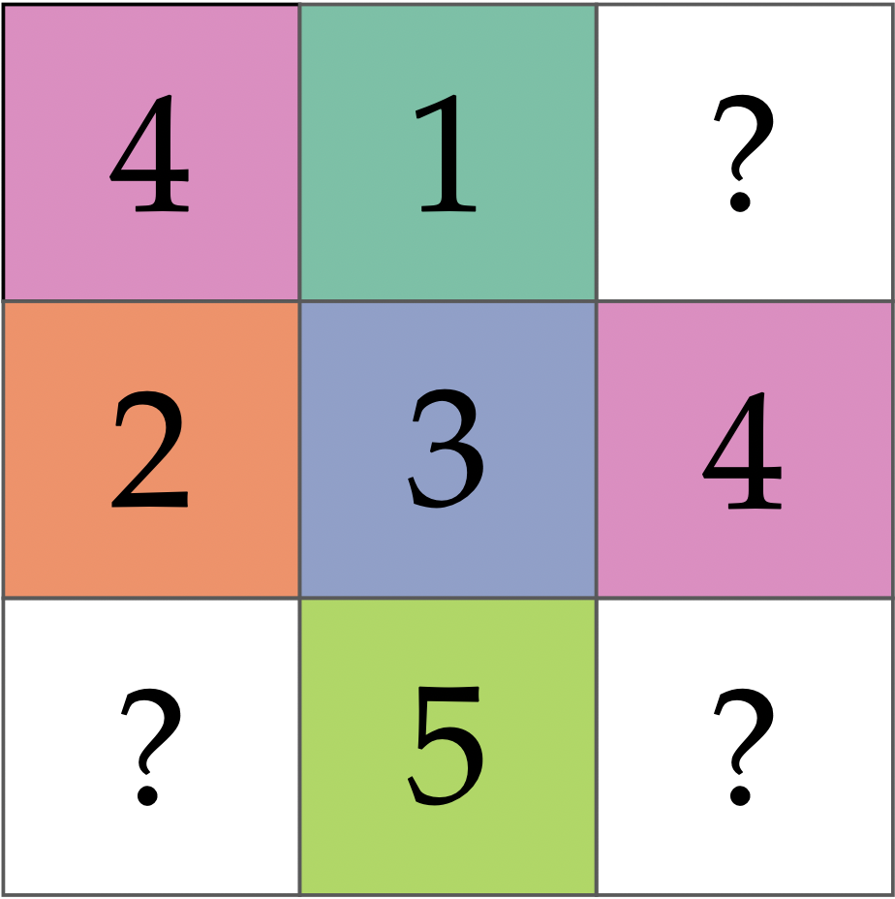
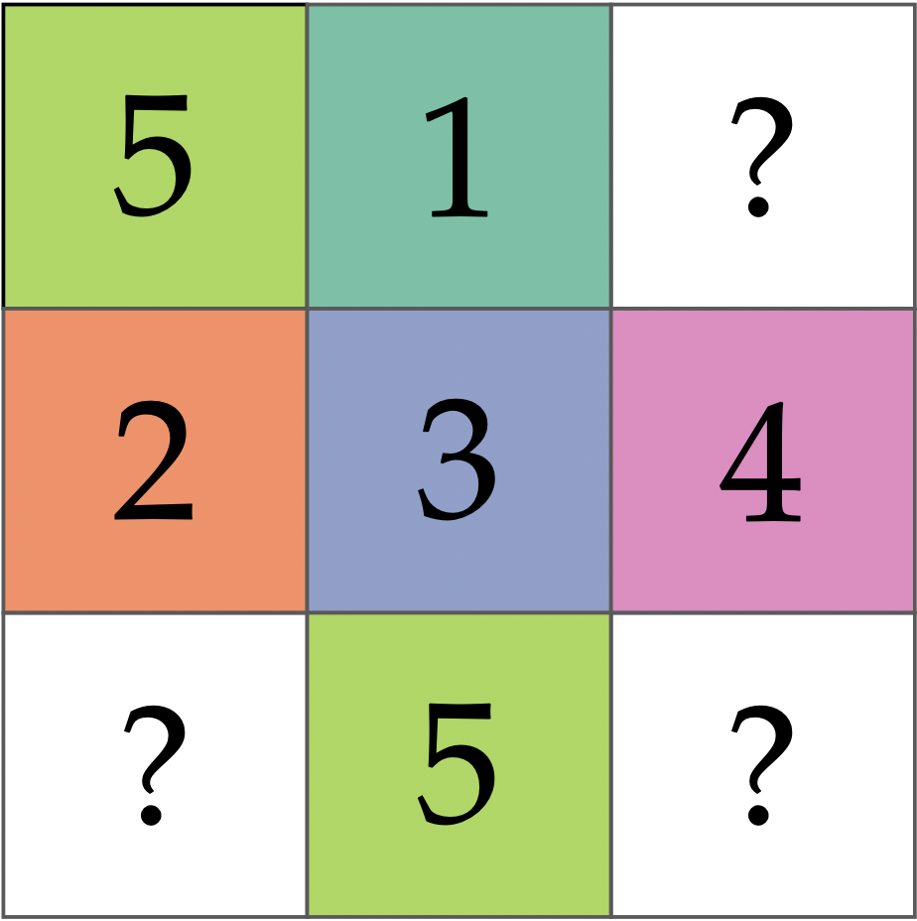


Symmetry Breaking
We can additional clauses to the Plus

Slide 33
What we did
1
Considered 1548 combinations of encodings
Evaluated them all (Kissat 4.0.4, personal computer)
Analyzed the data and made it publicly available
2
3

Slide 34
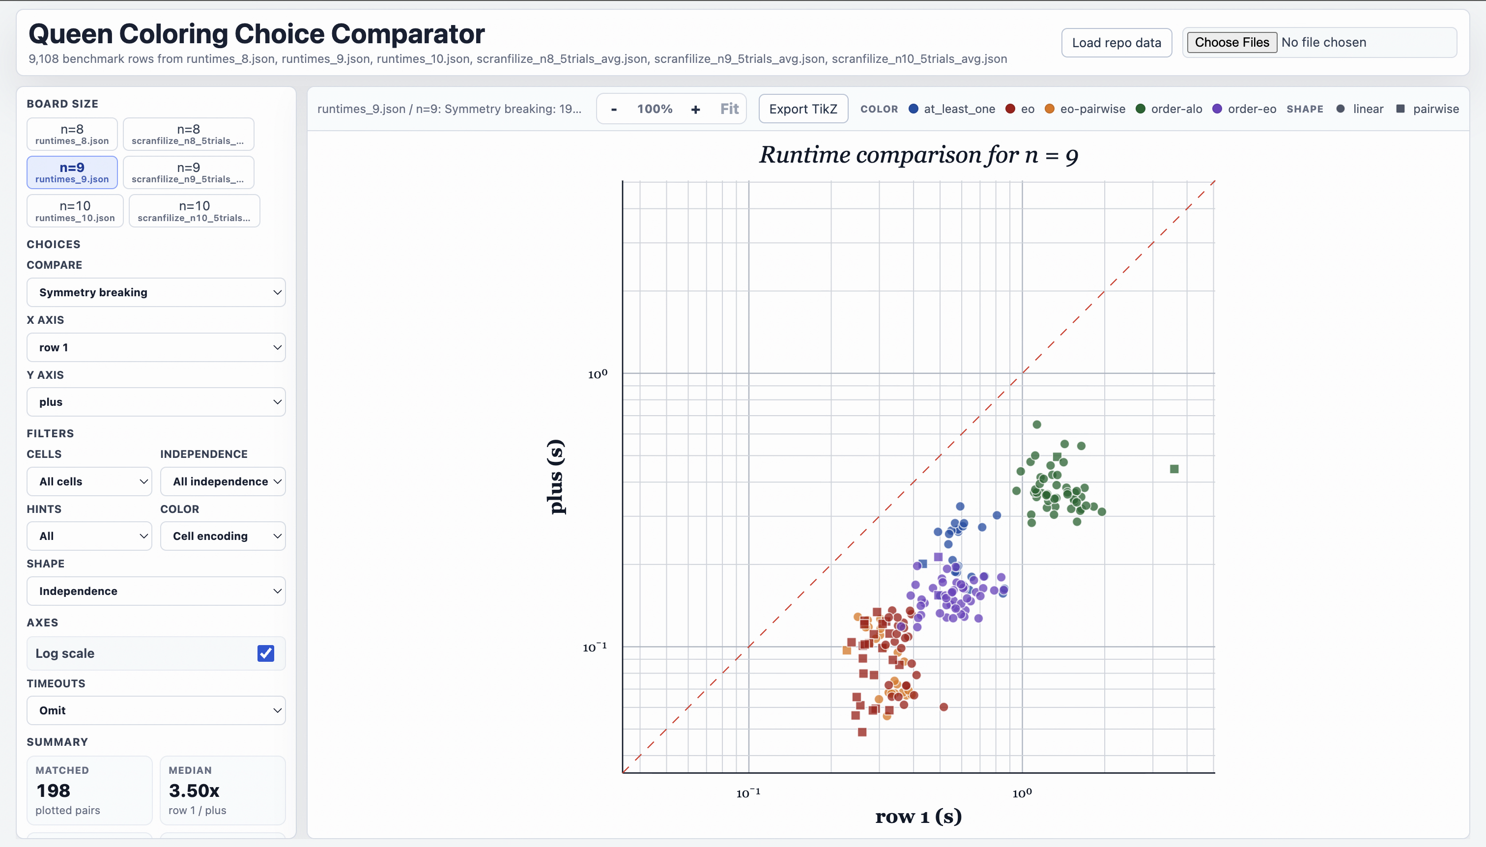
Have fun with the data!
https://queen-encodings.surge.sh/

Slide 35
Takeaways
1
Encoding choices have a large impact

Slide 36
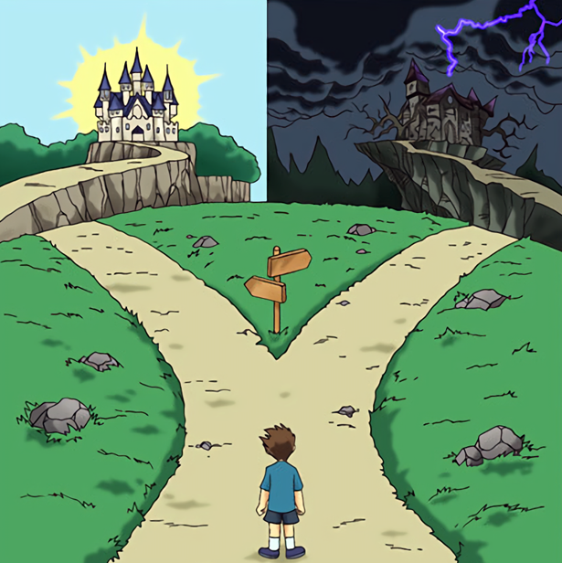
Takeaways
1
Encoding choices have a large impact
N=8
5 milliseconds
76 hours
Best encoding choices
minus sym. breaking
minus clique hints

Slide 37
Takeaways
1
Encoding choices have a large impact
With symmetry breaking and clique hints
N | Fastest | Slowest
9 | 0.048 s | 3.6 s
10 | 2.2 s | 538 s

Slide 38
Takeaways
1
Encoding choices have a large impact
2
Clique hints are really useful
N=9 with symmetry breaking and best parameters
No clique hints: 12 minutes
With clique hints: 0.048 seconds

Slide 39
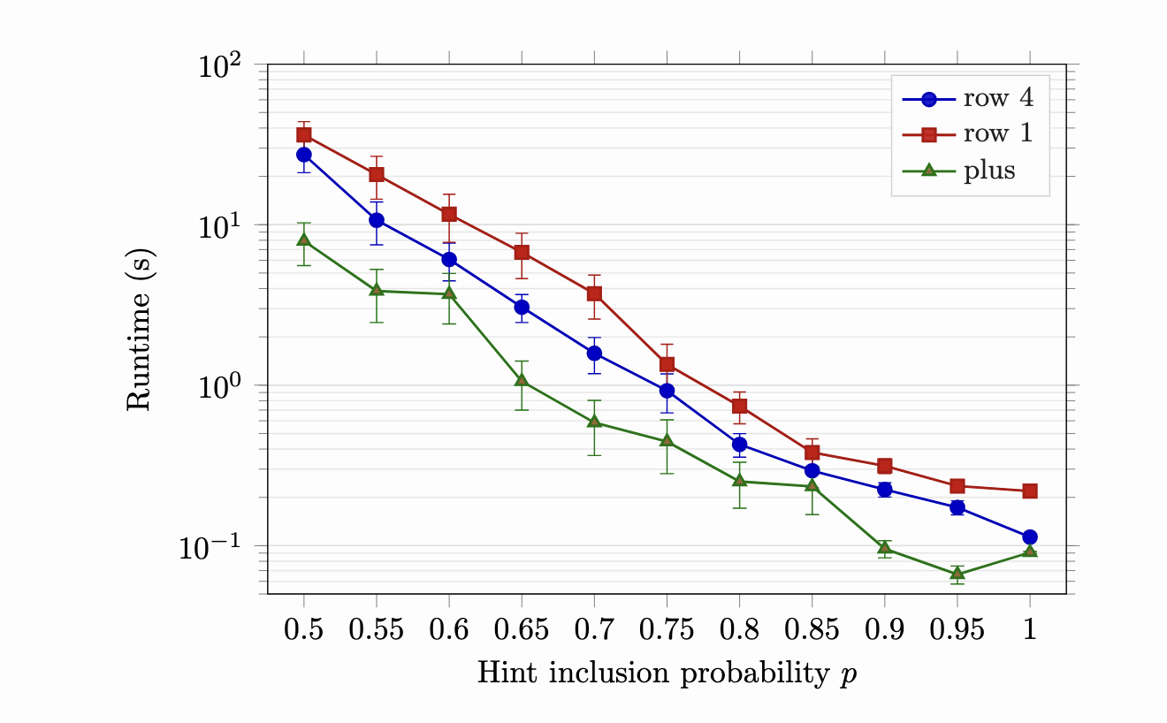
Takeaways
1
Encoding choices have a large impact
2
Clique hints are really useful

Slide 40
Takeaways
1
Encoding choices have a large impact
2
Clique hints are really useful
3
Consider alternative options for symmetry breaking

Slide 41
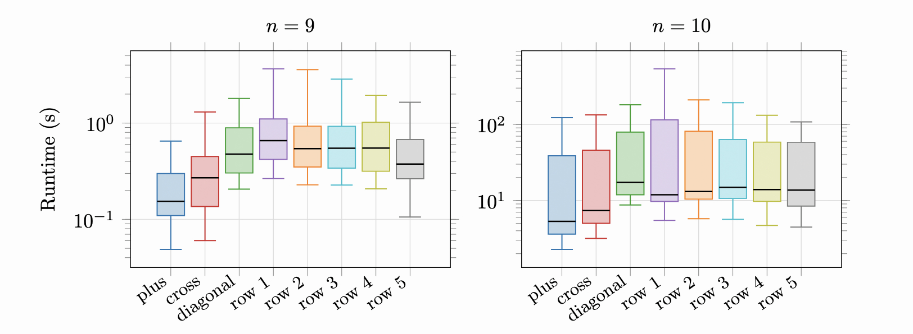
Takeaways
1
Encoding choices have a large impact
2
Clique hints are really useful
3
Consider alternative options for symmetry breaking

Slide 42
Takeaways
1
Encoding choices have a large impact
2
Clique hints are really useful
3
Consider alternative options for symmetry breaking
4
What works best for n=9 might be different from n=10

Slide 43
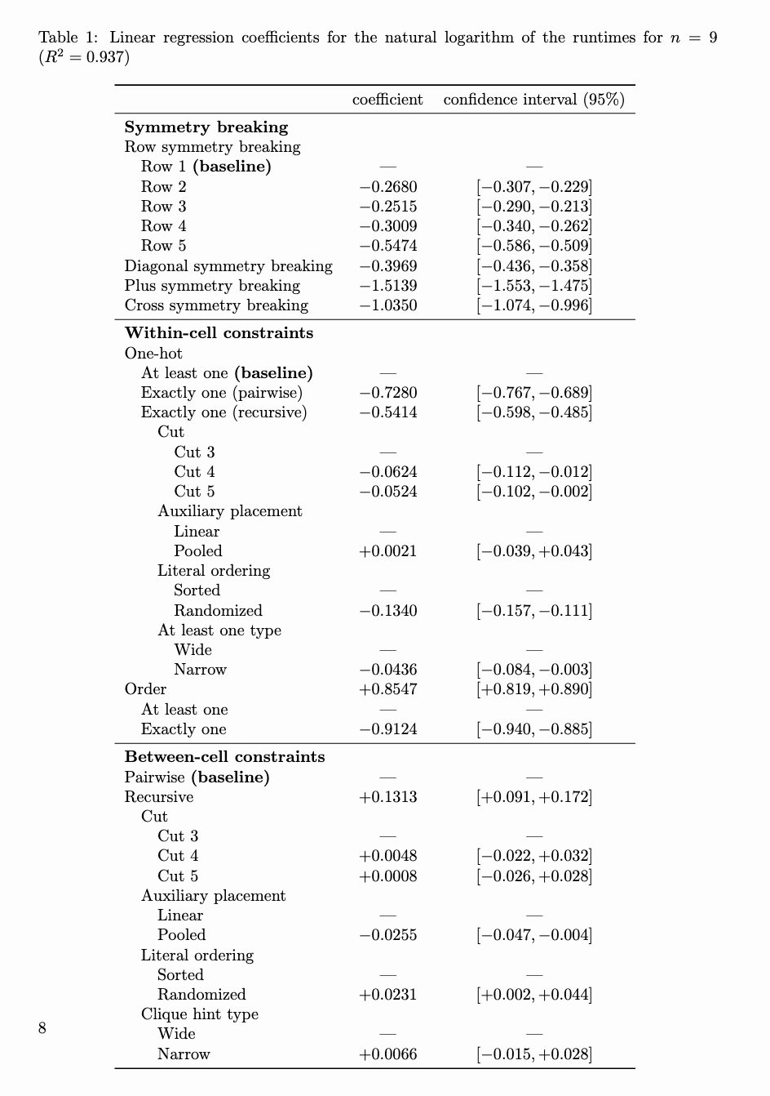
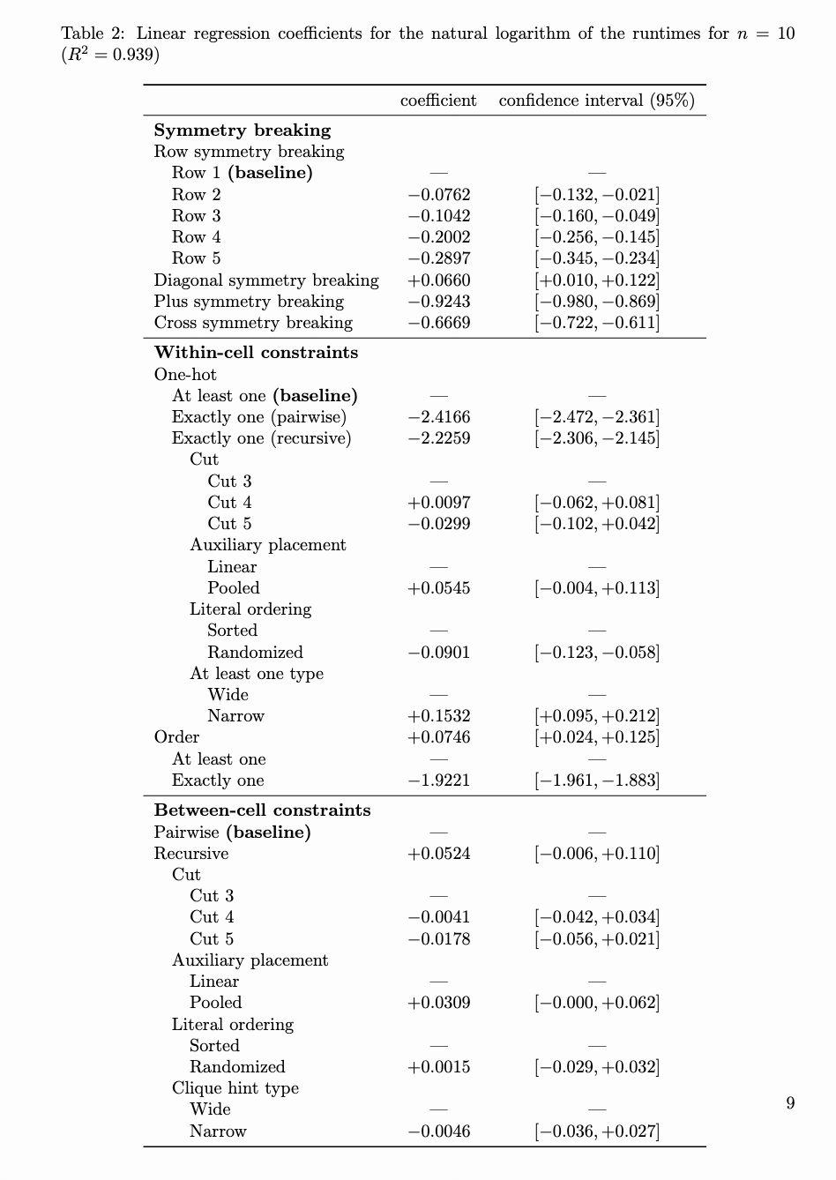
N = 9
N = 10

Slide 44
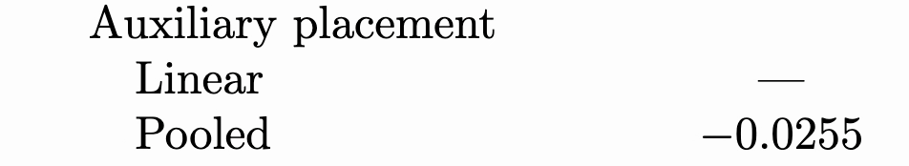
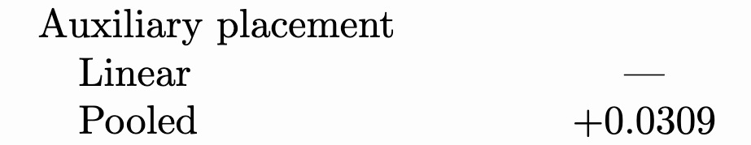
N = 9
N = 10

Slide 45
Takeaways
1
Encoding choices have a large impact
2
Clique hints are really useful
3
Consider alternative options for symmetry breaking
4
What works best for n=9 might be different from n=10
5
Solver are “brittle”

Slide 46
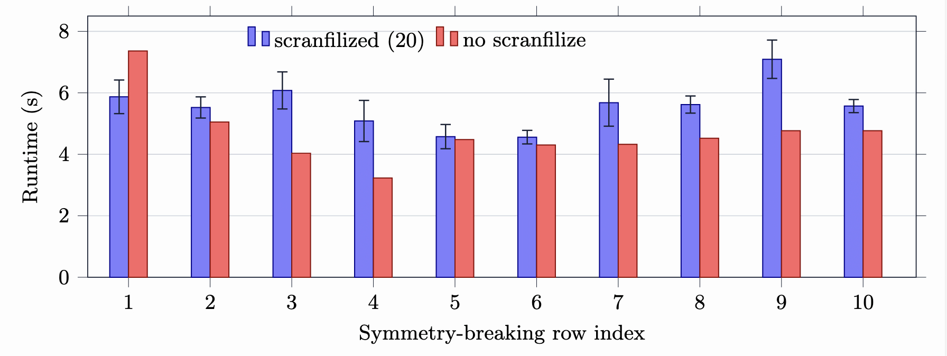
Is row i equivalent to row n-i+1?
Scranfilize := randomly permute formula

Slide 47
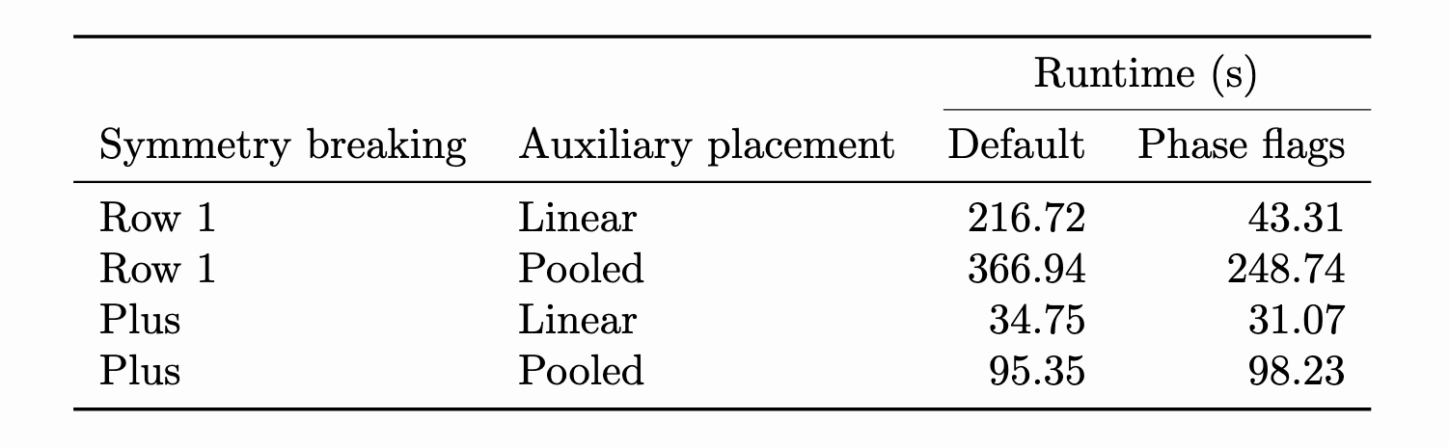
Averages are not always representative
Phase flags := --forcephase=1 --phase=0

Slide 48
Dream #1 for the future
Consider a much harder problem, in which the best combination of encoding choices and solver parameters takes 100 CPU hours
How can we find it?
(or a decent approximation)

Slide 49
Dream #2 for the future
Data like ours tells you that choice A worked better than choice B.
How can we understand why A was better than B?
In what contexts would we prefer B?

Slide 50
Coloring Queens with Thousands of Encodings
Bernardo Subercaseaux (bersub@cmu.edu)
Joint work with Benjamin Przybocki and Marijn Heule

Slide 51
Takeaways
Encoding choices have a large impact
Clique hints are really useful
Consider alternative options for symmetry breaking
What works best for n=9 might be different from n=10
Solvers are “brittle”
1
2
3
4
5

