Slide 1
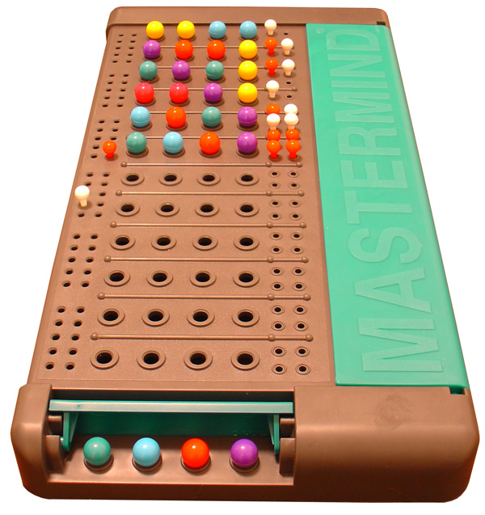

Price of Locality in Permutation Mastermind
Are Influencers CHAOTIC Enough?
Permutation Mastermind
Bernardo Subercaseaux
Carnegie Mellon University

Slide 2
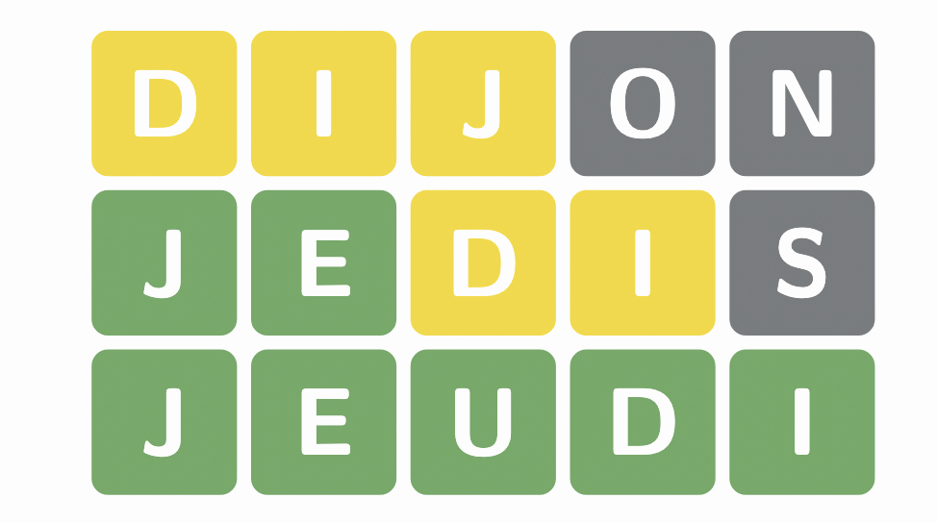
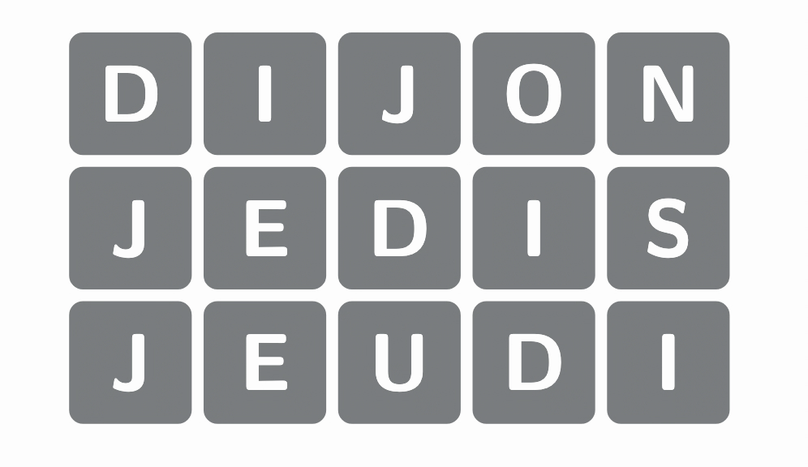
Mastermind
Wordle
3 ■
2 ■ 2 ■
5 ■

Slide 3
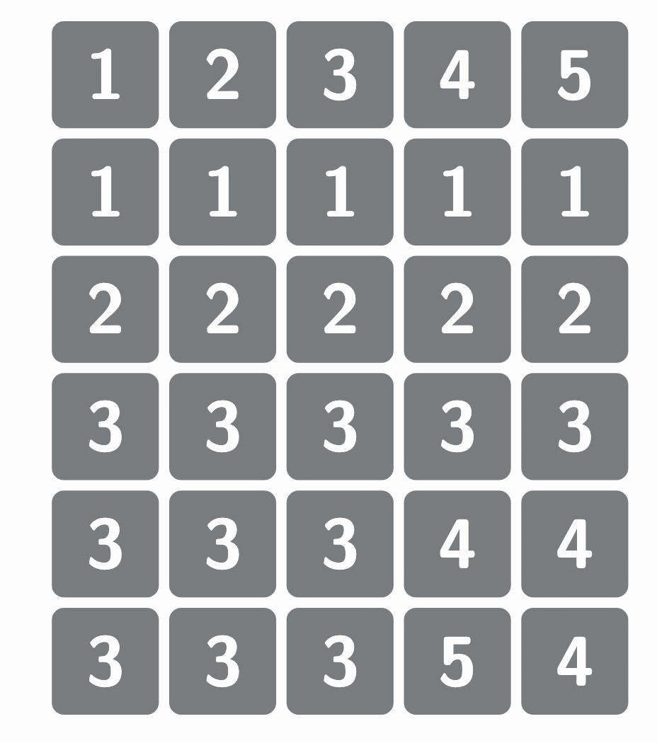
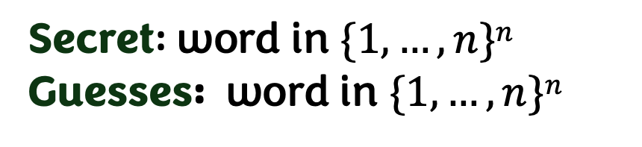
Mastermind
Secret: word in $\{1, …, n\}n$
Guesses: word in $\{1, …, n\}n$
1 ■ 2 ■
0
0
3 ■
4 ■
5 ■

Slide 4
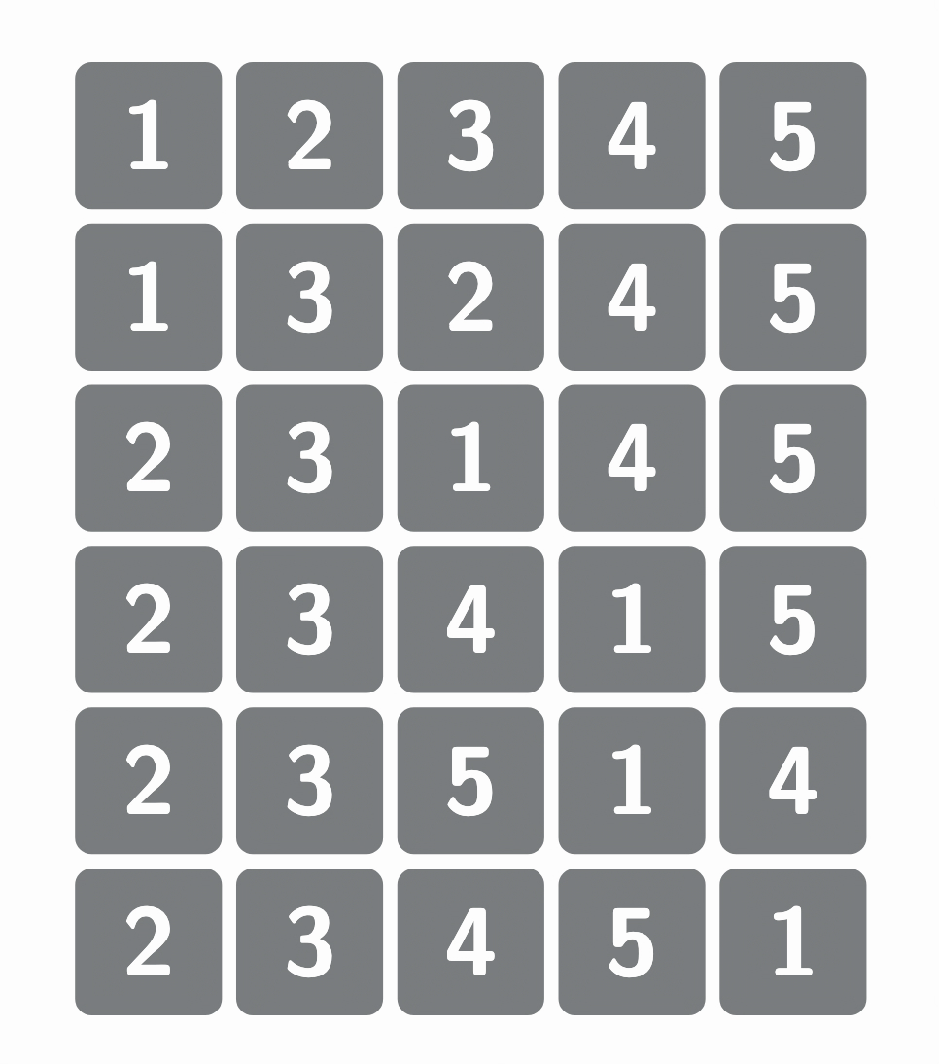
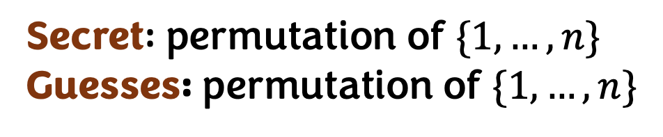
Mastermind
Permutation Mastermind
Secret: word in $\{1, …, n\}n$
Guesses: word in $\{1, …, n\}n$
Secret: permutation of $\{1, …, n\}$
Guesses: permutation of $\{1, …, n\}$
1 ■ 2 ■
5 ■
0
1 ■ 4 ■
0
2 ■ 3 ■
3 ■
3 ■ 2 ■
4 ■
2 ■ 3 ■
5 ■
5 ■

Slide 5
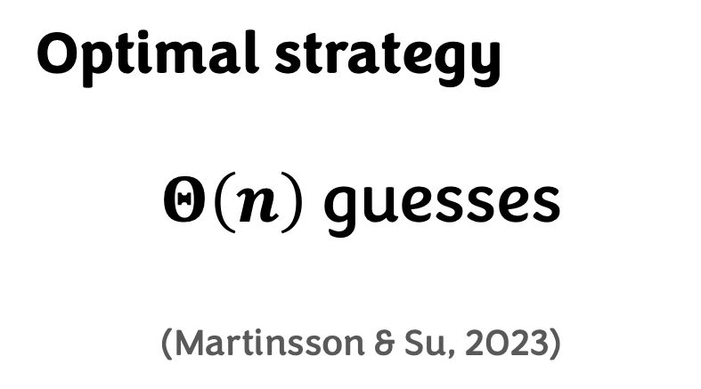
Mastermind
Permutation Mastermind
Secret: word in $\{1, …, n\}n$
Guesses: word in $\{1, …, n\}n$
Secret: permutation of $\{1, …, n\}$
Guesses: permutation of $\{1, …, n\}$
Optimal strategy
$Θ\left(n\right)$guesses
(Martinsson & Su, 2023)
Optimal Strategy

Slide 6
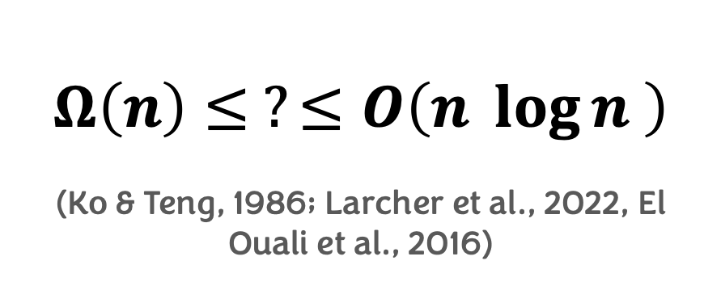
Mastermind
Permutation Mastermind
Secret: word in $\{1, …, n\}n$
Guesses: word in $\{1, …, n\}n$
Secret: permutation of $\{1, …, n\}$
Guesses: permutation of $\{1, …, n\}$
Optimal strategy
$Θ\left(n\right)$guesses
(Martinsson & Su, 2023)
Optimal Strategy
Optimal Strategy
$Ω\left(n\right)≤ ?≤O\left(n \log{n} \right)$
(Ko & Teng, 1986; Larcher et al., 2022, El Ouali et al., 2016)

Slide 7

Social media app based on short videos
More than 2 billion active users (monthly)

Slide 8
Social media app based on short videos
More than 2 billion active users (monthly)
Influencers
Audience
delivers content + branding
sponsors
Brands
$$
buys
$$

Slide 9
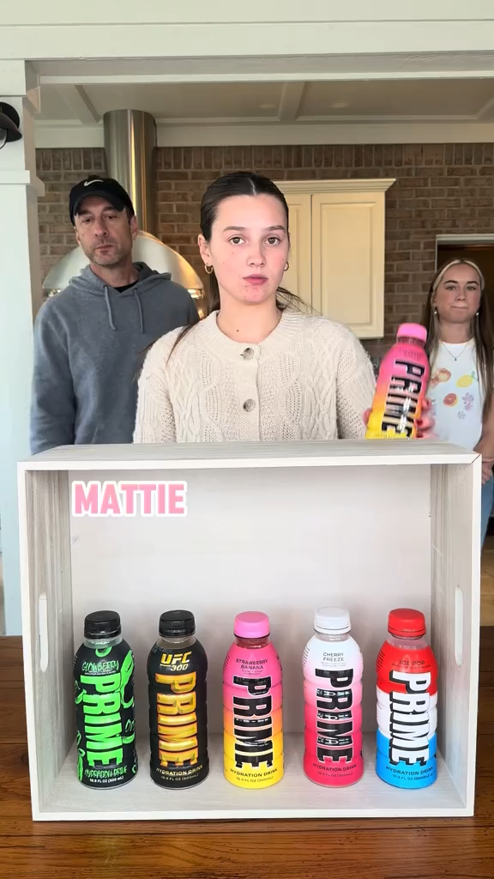
Permutation Mastermind

Slide 10
O(n lg n) static strategy from El Ouali et al.:
  Choose 28n lg n uniformly random permutations
  With positive probability there’s a unique compatible answer

Slide 11
Hypotheses
O(n lg n) static strategy from El Ouali et al.:
  Choose 28n lg n uniformly random permutations
  With positive probability there’s a unique compatible answer
Observation: People on TikTok seem to play by very “local” moves, but the known good strategies are very global
Hypothesis 1: Playing locally is worse

Slide 12
Hypotheses
O(n lg n) static strategy from El Ouali et al.:
  Choose 28n lg n uniformly random permutations
  With positive probability there’s a unique compatible answer
Observation: People on TikTok seem to play by very “local” moves, but the known good strategies are very global
Hypothesis 1: Playing locally is worse
Hypothesis 2: Playing locally is “easier”

Slide 13
Locality
1
2
3
4
5
6
2-local move
1
5
3
4
2
6

Slide 14
Locality
1
2
3
4
5
6
3-window-local move
1
2
3
5
6
4

Slide 15

Main Results
For $k$-local, we need $Ω\left(\frac{n^{2}}{k}\right)$ guesses

Slide 16

Main Results
For $k$-local, we need $Ω\left(\frac{n^{2}}{k}\right)$ guesses
For $2$-window-local, we can do $O\left(n^{2}\right)$ “static” guesses

Slide 17

Main Results
For $k$-local, we need $Ω\left(\frac{n^{2}}{k}\right)$ guesses
For $2$-window-local, we can do $O\left(n^{2}\right)$ “static” guesses
Permutation Mastermind is NP-hard, also in the $3$-local variant. But 2-local admits $O(n^{7})$ randomized algo (!)

Slide 18
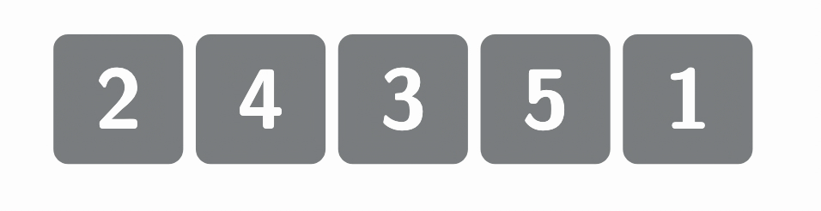

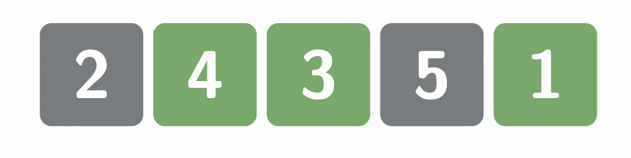
Generous adversary
Suppose secret is 2 4 3 5 1
Normal adversary
3 ■

Slide 19
Super-generous adversary
1
2
3
4
5
1
5
3
2
4
Allows a k-local move to be given one-arrow-at-a-time,
and immediately replies if the arrow is good

Slide 20
Super-generous adversary
1
2
3
4
5
1
5
3
2
4
Allows a k-local move to be given one-arrow-at-a-time,
and immediately replies if the arrow is good
If we prove a lower bound of T arrow tests against super-generous adversary, it implies a T/k lower bound!

Slide 21
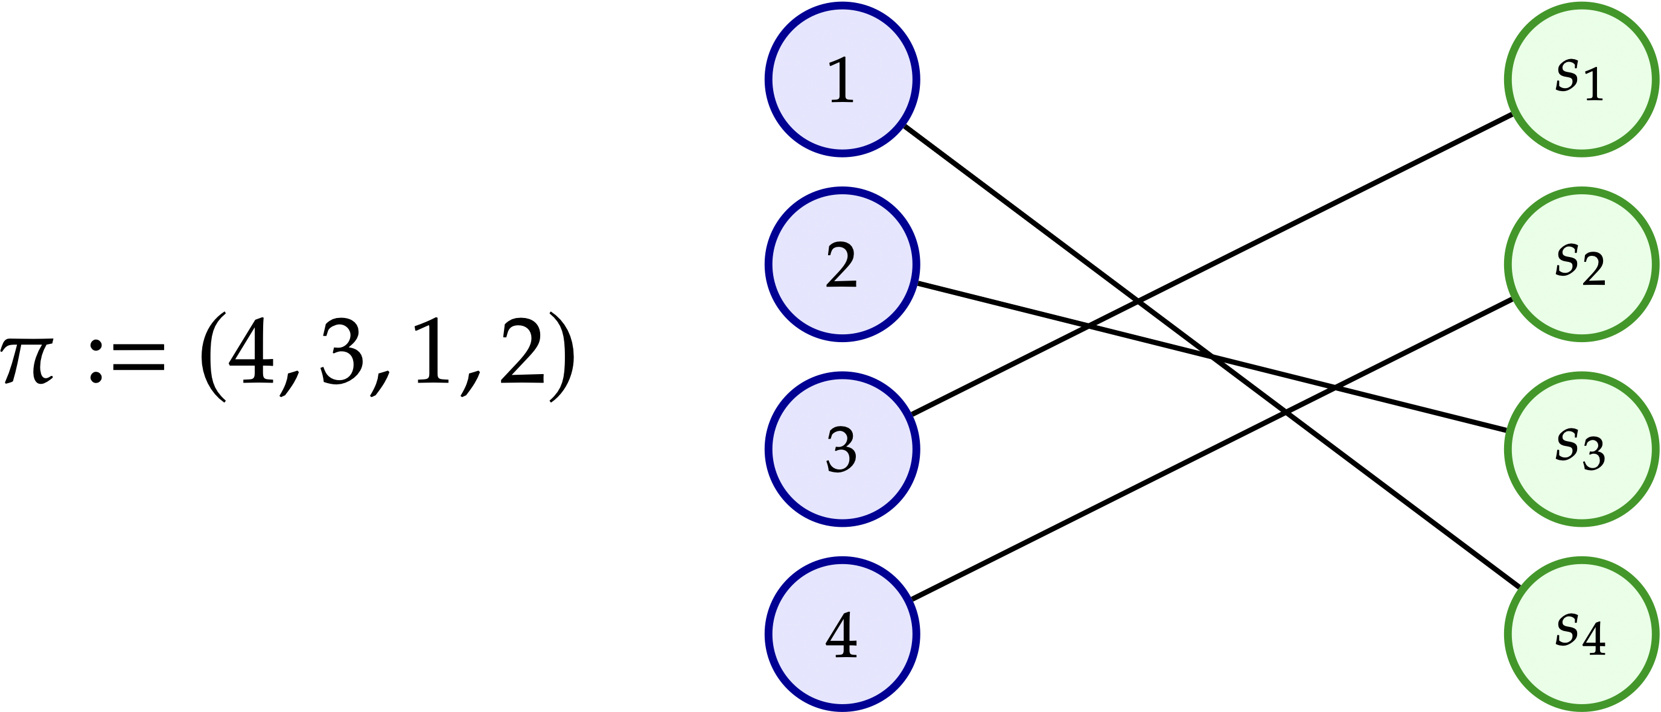
Permutations = Perfect Matchings
positions
symbols

Slide 22
Permutations = Perfect Matchings
positions
symbols
We should think of a secret perfect matching, and that in each “micro-guess” we’re changing one edge; the super-generous adversary replies with the intersection of our current matching and the secret

Slide 23
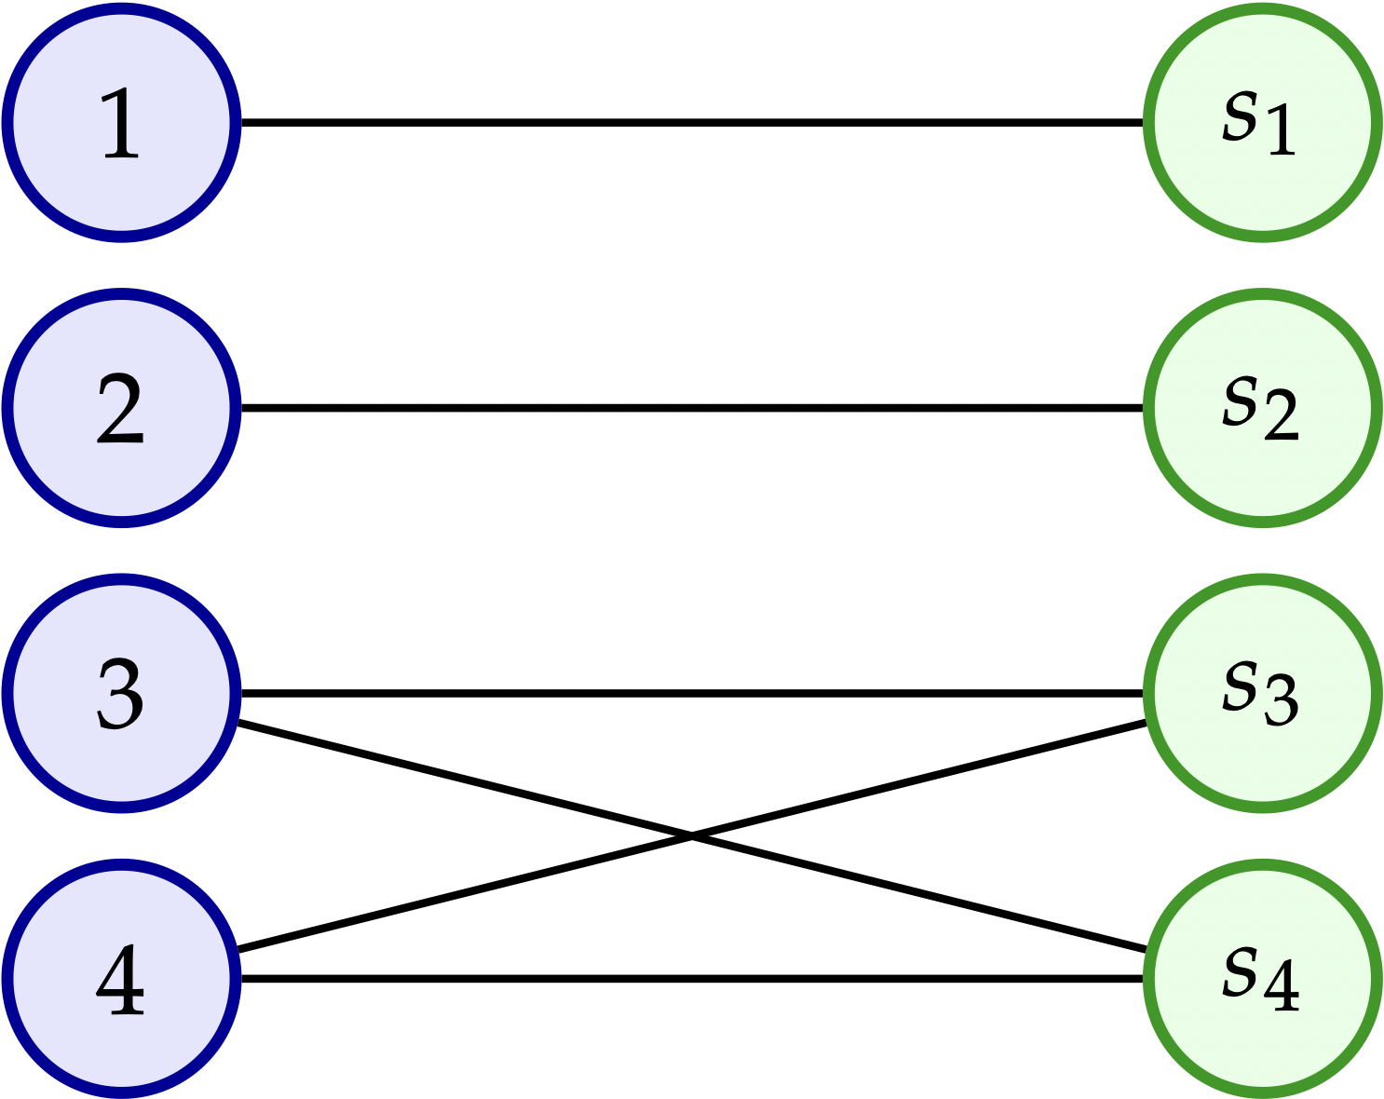
Graph of possible secrets
Keep only edges that are “compatible” with the feedback received thus far

Slide 24
Graph of possible secrets
Keep only edges that are “compatible” with the feedback received thus far
We win exactly when the graph of possible secrets has a unique perfect matching

Slide 25
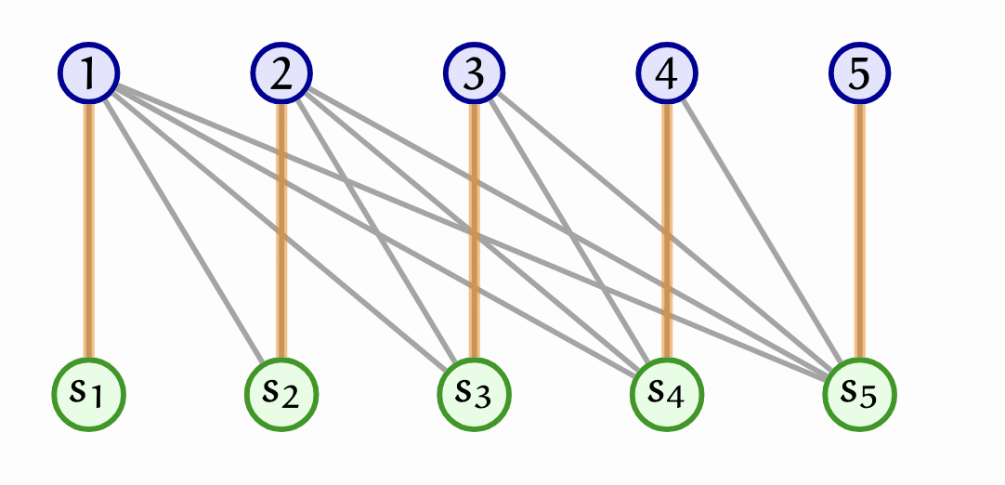
Graph of possible secrets
We win exactly when the graph of possible secrets has a unique perfect matching

Slide 26
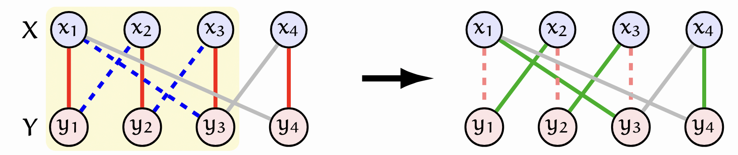
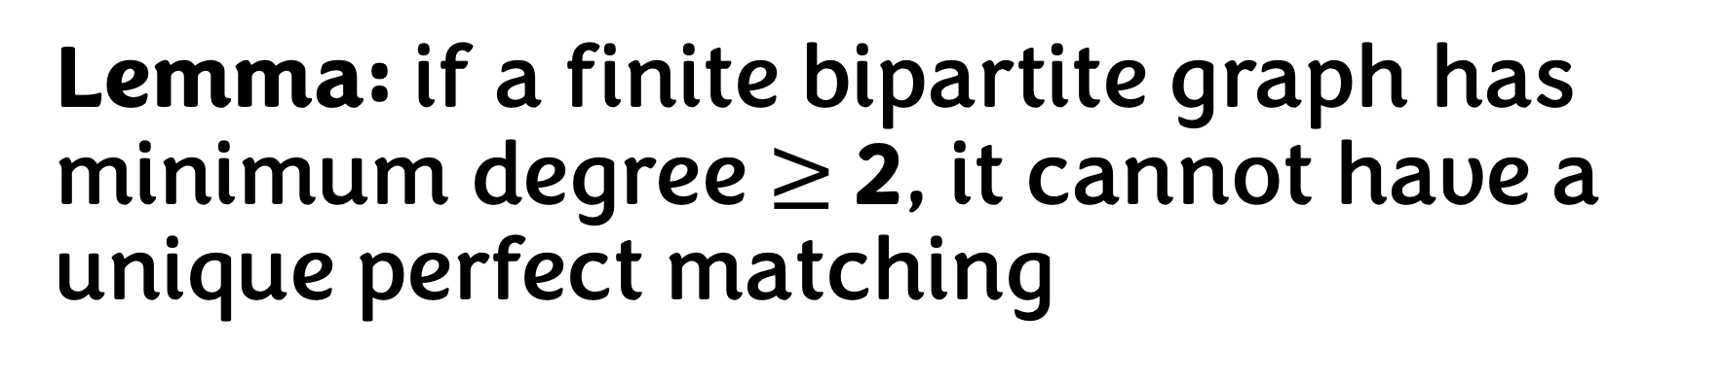
Lemma: if a finite bipartite graph has minimum degree $≥$ 2, it cannot have a unique perfect matching
Take any vertex, then take a matching edge
then a non-matching edge
then a matching edge
then a non-matching edge
…
until completing a cycle

Slide 27
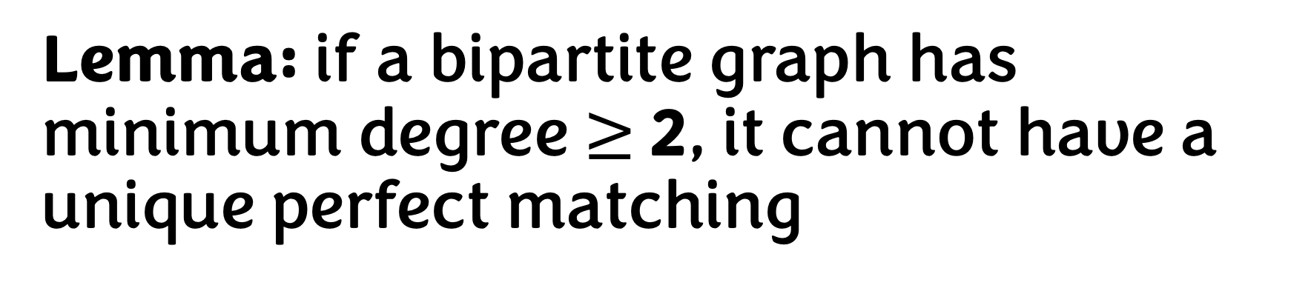
Lemma: if a bipartite graph has minimum degree $≥$ 2, it cannot have a unique perfect matching

Slide 28
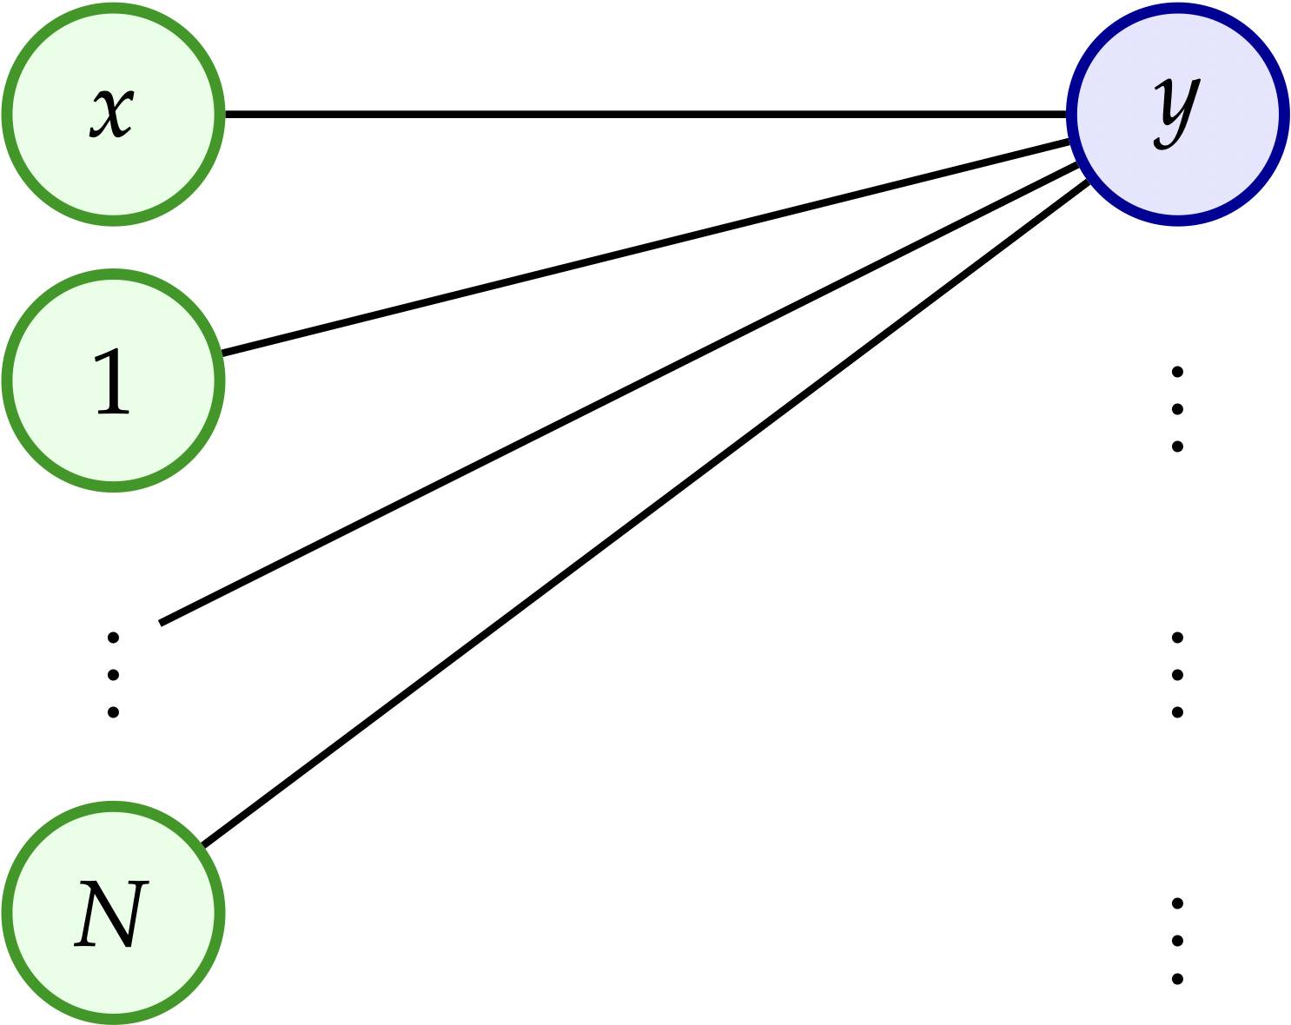
Claim: if an (N, N) bipartite graph has a unique perfect matching, then it has at most (N+1 choose 2) edges
Suppose we have an (N, N) bipartite graph with a unique perfect matching M.
By the lemma, there’s some vertex x with degree 1,
so it has a unique neighbor y (and thus M(x) = y).

Slide 29
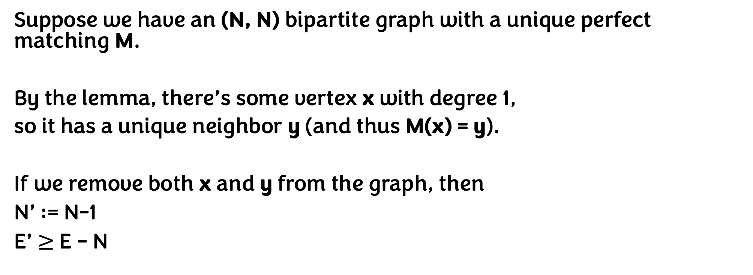
Claim: if an (N, N) bipartite graph has a unique perfect matching, then it has at most (N+1 choose 2) edges
Suppose we have an (N, N) bipartite graph with a unique perfect matching M.
By the lemma, there’s some vertex x with degree 1,
so it has a unique neighbor y (and thus M(x) = y).
If we remove both x and y from the graph, then
N’ := N-1
E’ $≥$ E - N

Slide 30
Claim: if an (N, N) bipartite graph has a unique perfect matching, then it has at most (N+1 choose 2) edges
Suppose we have an (N, N) bipartite graph with a unique perfect matching M.
By the lemma, there’s some vertex x with degree 1,
so it has a unique neighbor y (and thus M(x) = y).
If we remove both x and y from the graph, then
N’ := N-1
E’ $≥$ E - N
Do this until the graph is empty:
We remove at most N + (N-1) + (N-2) + … + 1 edges!

Slide 31
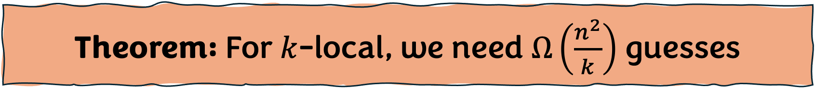
Theorem: For $k$-local, we need $Ω\left(\frac{n^{2}}{k}\right)$ guesses

Slide 32
Theorem: For $k$-local, we need $Ω\left(\frac{n^{2}}{k}\right)$ guesses
1. Before any guesses the graph of possible secrets is complete, so $n^{2}$edges

Slide 33
Theorem: For $k$-local, we need $Ω\left(\frac{n^{2}}{k}\right)$ guesses
1. Before any guesses the graph of possible secrets is complete, so $n^{2}$edges
2. In the worst case, the first guess eliminates only n edges

Slide 34
Theorem: For $k$-local, we need $Ω\left(\frac{n^{2}}{k}\right)$ guesses
1. Before any guesses the graph of possible secrets is complete, so $n^{2}$edges
2. In the worst case, the first guess eliminates only n edges
3. We still need to eliminate $Ω\left(n^{2}\right)$ edges for a unique perfect matching

Slide 35
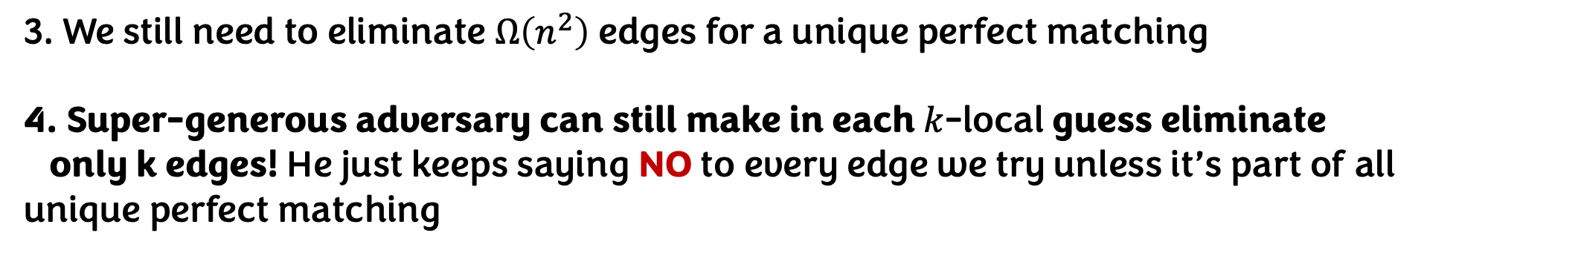
Theorem: For $k$-local, we need $Ω\left(\frac{n^{2}}{k}\right)$ guesses
1. Before any guesses the graph of possible secrets is complete, so $n^{2}$edges
2. In the worst case, the first guess eliminates only n edges
3. We still need to eliminate $Ω\left(n^{2}\right)$ edges for a unique perfect matching
4. Super-generous adversary can still make in each $k$-local guess eliminate
only k edges! He just keeps saying NO to every edge we try unless it’s part of all
unique perfect matching

Slide 36

For $2$-window-local, we can do $O\left(n^{2}\right)$ “static” guesses

Slide 37
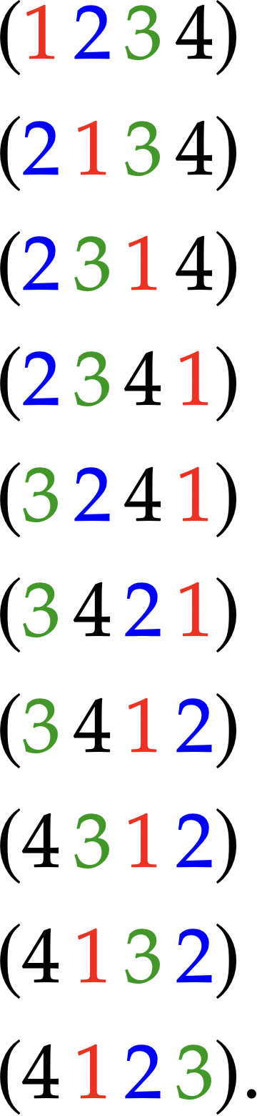

For $2$-window-local, we can do $O\left(n^{2}\right)$ “static” guesses
“Conveyor belt” strategy

Slide 38
For $2$-window-local, we can do $O\left(n^{2}\right)$ “static” guesses
Suppose the adversary was generous, and told us when something is correct.
Then after the conveyor belt strategy we would know the answer, since each element passes through every position
“Conveyor belt” strategy

Slide 39
For $2$-window-local, we can do $O\left(n^{2}\right)$ “static” guesses
Suppose the adversary was generous, and told us when something is correct.
Then after the conveyor belt strategy we would know the answer, since each element passes through every position

Slide 40

For $2$-window-local, we can do $O\left(n^{2}\right)$ “static” guesses
Suppose the adversary was generous, and told us when something is correct.
Then after the conveyor belt strategy we would know the answer, since each element passes through every position
Trick: we can pay for generosity !

Slide 41
For $2$-window-local, we can do $O\left(n^{2}\right)$ “static” guesses
Trick: we can pay for generosity !
…. 4 7 9 ... Score: 5
…. 7 4 9 ... Score: 6

Slide 42
For $2$-window-local, we can do $O\left(n^{2}\right)$ “static” guesses
Trick: we can pay for generosity !
Simulate with:
…. 4 7 9 ...
…. 7 4 9 ...
…. 7 9 4 …
…. 9 7 4 …
…. 9 4 7 …
…. 4 9 7 …
…. 4 7 9 …
…. 7 4 9 …
…. 4 7 9 ... Score: 5
…. 7 4 9 ... Score: 6

Slide 43
For $2$-window-local, we can do $O\left(n^{2}\right)$ “static” guesses
Trick: we can pay for generosity !
Simulate with:
…. 4 7 9 ...
…. 7 4 9 ...
…. 7 9 4 …
…. 9 7 4 …
…. 9 4 7 …
…. 4 9 7 …
…. 4 7 9 …
…. 7 4 9 …
…. 4 7 9 ... Score: 5
…. 7 4 9 ... Score: 6
Here the score changes must reveal which one is right!

Slide 44

Permutation Mastermind is NP-hard, also in the $3$-local variant. But 2-local admits $O(n^{7})$ randomized algo (!)
Interesting reduction from Monotone-1-in-3-SAT
The 2-local case uses an algorithm from Geelen and Kapadia (2017) for t-dimensional perfect matching with parity constraints

Slide 45
Price of Locality in Permutation Mastermind
Are Influencers CHAOTIC Enough?
Permutation Mastermind
Bernardo Subercaseaux
Carnegie Mellon University

